Slide 1
BASH SCRIPTING
BASH SCRIPTING
Virtual Machine Management
Substitution

Slide 2
Contents
Install packages for VM Management
Create a VM
Interact with a VM
SSH into a VM
Encrypted Storage
Swap Space

Slide 3
Manage and configure Virtual Machines
Step 1- Check whether Virtualization is enabled
As we get started out, we need to check if your system supports Virtualization technology. To achieve this, run the following command.
$ egrep -c '(vmx|svm)' /proc/cpuinfo
Next, confirm if your system can run KVM virtual machines.
$ kvm-ok
Step 2- Install KVM, Qemu, virt-manager & libvirtd daemon
The next step is to install KVM and associated packages. So, run the command:
$ sudo apt install -y qemu qemu-kvm libvirt-daemon libvirt-clients bridge-utils virt-manager
The command installs the following packages.
qemu-kvm – This is the main KVM package that provides virtualization support.
libvirt – Includes the libvirtd daemon which supports creation and management of virtual machines.
libvirt-client – This package provides the virsh utility used for interacting with virtual machines.
virt-install – A utility that helps you to create virtual machines and install OS on those virtual machines from command line.
virt-viewer – A utility that displays the graphical view for the virtual machine
T

Slide 4
Create a New VM
Step-3 Once installed, we need to confirm if the required kvm modules are loaded. Therefore, run the command:
$ lsmod | grep kvm
Additionally, confirm that the libvirtd daemon is running as follows.
$ sudo systemctl status libvirtd.service
Create a VM
$ sudo virt-install --name=debian-vm --os-type=Linux --os-variant=debian9 --vcpu=2 --ram=2048 --disk path=/var/lib/libvirt/images/Debian.img,size=15 --graphics spice --location=/home/james/Downloads/debian-11.1.0-amd64-DVD-1.iso --network bridge:virbr0
Let’s take a minute and analyze this command:
The –name attribute denotes the name of the virtual machine. Feel free to give it an arbitrary name.
The –os-type directive specifies the type of Operating system – in this case Linux.
The –os-variant option specifies the operating system releases.
Moving on, the –vcpu parameter specifies the number of CPU cores to be allocated to the virtual machine.
The –ram option specifies the amount of RAM in Megabytes to be allocated.
The –disk path option defines the path of the virtual machine image. The –disk directive is the disk space of the VM in Gigabytes.
The –graphics option specifies the graphical tool for interactive installation, in this example, we are using spice.
The –location option points to the location of the ISO image
Lastly, the –network bridge directive specifies the interface to be used by the virtual machine

Slide 5
Interacting with VMs
Step 4- Interacting with virtual machines
The virsh utility is a component that is used to interact with virtual machines on the command-line. For instance, to view the currently running virtual machines, execute the command:
$ virsh list
To shut down a virtual machine use the syntax:
$ sudo virsh shutdown vm_name
To start or power on the virtual machine, run:
$ sudo virsh start debian-vm
To reboot the machine, run the command:
$ sudo virsh reboot debian-vm
$ sudo virsh destroy debian-vm

Slide 6
SSH from one VM to another
Here’s simplified model of how SSH works. You create a pair of keys on your local computer. A public key and a private key. Messages encrypted using Public key can be decrypted using the private key and vice versa. These keys are usually stored on your local computer at a path ~/.ssh/id_rsa(private key) and~/.ssh/id_rsa.pem(the public key).
You then go to your remote server, login to a console as a regular or root user, open up the file ~/.ssh/authorized_keysof that server. Here you enter the contents of your public key as it is. Once that is done, you can ssh as that user on the server whose .ssh directory has the authorized_keys, from your local device.
SSH-keys Setup
First make sure, if there are no ssh-keys already in your home directory. Check the contents of your home directory’s .ssh folder. and then execute the following:
$ ssh-keygen
Verify that the keys are created by checking the contents of your ~/.ssh folder.
$ ls -al ~/.ssh
If you see files matching the default values displayed in the ssh-keygen prompt then everything has worked fine.

Slide 7
SSH from one VM to another
Now open up a console to your Virtual Machine. First check if your VM has SSH server running or not.
$ service sshd status
If it is not installed, use your package manager to search and install OpenSSH server. Once that is done make sure that your VM’s firewall is open on port number 22. For example, if you are using Ubuntu as a VM, the default firewall ufw should either be disabled or should allow port 22 connections like so:
$ sudo ufw status
if is not open at port 22, use the follow command:
$ sudo ufw allow ssh
Next open up the file ~/.ssh/authorized_keys on your VM, using your favorite text editor. You may want to enable host-to-guest or bidirectional clipboard for this next step.
Inside this file (at the bottom of the file, if it is not empty) paste in the contents of your public key. The last part where it says your name and the local host where the keys were generated is not that important as the rest of the string.
Once that is in place, restart your SSH server.
$ service sshd restart
Now you can use the regular password that you use to login to your VM to ssh into it as well.

Slide 8
Virtualbox Settings
For you to ssh into your VM, both your local computer (the one with the private key) and the VM should be on the same network. So you can reach to that VM’s IP address.
Let’s consider the example of a typical home router setup. Your computer, along with other devices, is connected to the home router. This router also acts as a DHCP server, meaning it assigns each device that’s connected to it, a unique private IP address. Your desktop gets an IP, so does your phone and your laptop. Only the devices that are connected to this router can talk to one another via their IP addresses.
Enable bridged networking mode in the settings of your VM and the VM will show up as being connected to your home router (or a similar DHCP server) with a private IP.

Slide 9
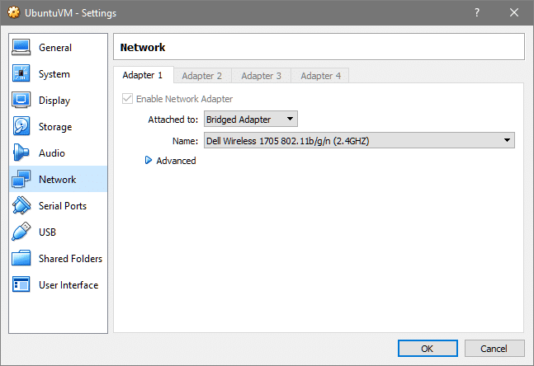
Bridged Network

Slide 10
SSH Syntax
Once you know the IP address of your VM, you can SSH into it by running the command:
$ ssh <username>@ip.address.of.your.vm

Slide 11
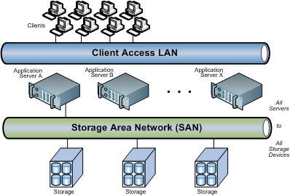
SAN
A SAN and network-attached storage (NAS) are two different types of shared networked storage solutions. While a SAN is a local network composed of multiple devices, NAS is a single storage device that connects to a local area network (LAN).
A Storage Area Network (SAN) is a specialized, high-speed network that provides network access to storage devices. SANs are typically composed of hosts, switches, storage elements, and storage devices that are interconnected using a variety of technologies, topologies, and protocols. SANs may span multiple sites.
A SAN presents storage devices to a host such that the storage appears to be locally attached. This simplified presentation of storage to a host is accomplished through the use of different types of virtualization.

Slide 12
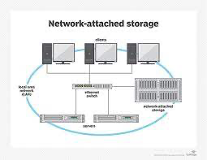
NAS
Network-attached storage (NAS) is a file-level (as opposed to block-level storage) computer data storage server connected to a computer network providing data access to a heterogeneous group of clients. The term "NAS" can refer to both the technology and systems involved, or a specialized device built for such functionality (as unlike tangentially related technologies such as local area networks, a NAS device is often a singular unit).
A NAS device is optimised for serving files either by its hardware, software, or configuration. It is often manufactured as a computer appliance – a purpose-built specialized computer. NAS systems are networked appliances that contain one or more storage drives, often arranged into logical, redundant storage containers or RAID.

Slide 13
List, create, delete, and modify physical storage partitions
To list partitions, we can use fdisk. We’ll do so to see our setup on start.
To create a new partition on the empty disk, we’ll provide it as argument to fdisk:

Slide 14
Manage and configure LVM storage
Logical Volume Manager (LVM) is a software-based RAID-like system that lets you create "pools" of storage and add hard drive space to those pools as needed. There are lots of reasons to use it, especially in a data center or any place where storage requirements change over time. Many Linux distributions use it by default for desktop installations, though, because users find the flexibility convenient and there are some built-in encryption features that the LVM structure simplifies.
In a modern world every Server needs more space day by day for that we need to expand depending on our needs. Logical volumes can be use in RAID, SAN. A Physical Disk will be grouped to create a volume Group. Inside volume group we need to slice the space to create Logical volumes. While using logical volumes we can extend across multiple disks, logical volumes or reduce logical volumes in size with some commands without reformatting and re-partitioning the current disk. Volumes can stripes data across multiple disks this can increase the I/O stats.

Slide 15

Creating, Resizing and Removing LVM Components
You must have root privilege to run any LVM command. So, first of all, you have to run LVM with root password.
$ sudo lvm
$sudo lvmdiskscan
Run the command to find all existing block devices. In the output, it is shown that there are two partitions which are /dev/sda1 and /dev/sda5, 1 disk in /dev/sdb and no physical volumes.
Create Physical Volume
pvcreate command is used to create physical volume from storage devices. Here, /dev/sdb is used for creating a physical volume. Run the commands to create a physical volume of 5GB. The success message will appear if the physical volume creates successfully.
You can also use pvdisplay command to find the existing physical volumes.
Lvm> pvdisplay
Create Volume Group
You can create a volume group after creating a physical volume. vgcreate command is used to create new volume group.

Slide 16

lvm> vgcreate vg1 /dev/sdb
vgdisplay command is used to get the information of existing volume groups. Run the command to show the output.
lvm> vgdisplay
Run the following vgcreate command to create a volume group of size, 100M.
lvm> vgcreate -s 100M vg1 /dev/sdb
Now, vgdisplay will show the following output.

Slide 17
Create and configure encrypted storage
$ sudo apt-get install cryptsetup (for Debian distributions)
$ sudo yum install cryptsetup (for RHEL/CentOS distributions)
$ sudo cryptsetup luksFormat /dev/sdb1
$ lsblk -f
$ sudo cryptsetup luksOpen /dev/sdb1 cryptpart
$ sudo mkfs.ext4 /dev/mapper/cryptpart
You can now mount it and add new files to it. Files created on this volume will automatically be encrypted.
$ mkdir -p /home/devconnected/files
$ sudo mount /dev/mapper/cryptpart /home/devconnected/files
$ sudo chown suchintan:suchintan /home/devconnected/files

Slide 18
What is Swap Space
Swap is a portion of hard drive storage that has been set aside for the operating system to temporarily store data that it can no longer hold in RAM. This lets you increase the amount of information that your server can keep in its working memory, with some caveats. The swap space on the hard drive will be used mainly when there is no longer sufficient space in RAM to hold in-use application data.
The information written to disk will be significantly slower than information kept in RAM, but the operating system will prefer to keep running application data in memory and use swap for the older data.
Swap space can take the form of either a dedicated swap partition or a swap file. Generally when running Ubuntu on a virtual machine, a swap partition is not present, and the only option is to create a swap file.

Slide 19
Configure and manage swap space
sudo swapon --show
free -h
df -h
sudo fallocate -l 1G /swapfile
ls -lh /swapfile
sudo chmod 600 /swapfile
sudo mkswap /swapfile
sudo swapon /swapfile
sudo swapon --show

